Slide 1
Basic math
Hosein Ghahremanzadeh
Notes:
The background is a sample of volumetric lighting in my own 3D graphics engine, HG3D

Slide 2
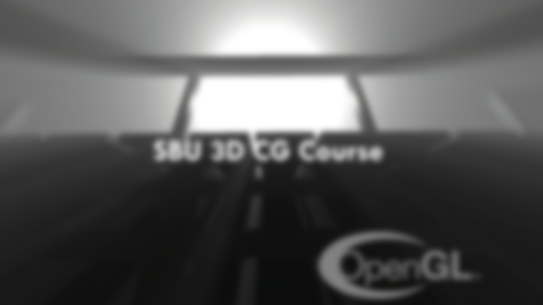
What we’re going to discuss
I’ll be discussing some basic math that you are going to need, in order to understand some of the parts of OpenGL pipeline and basics of rendering.
Notes:
The math we’re going to study is mostly about linear algebra, we’re going to start from basic vector math to more complicated stuff such as barycentric coordinates.

Slide 3
Homogeneous coordinates
In mathematics, homogeneous coordinates or projective coordinates, introduced by August Ferdinand Möbius in his 1827 work Der barycentrische Calcül.
Notes:
This is the base of computer graphics math

Slide 4
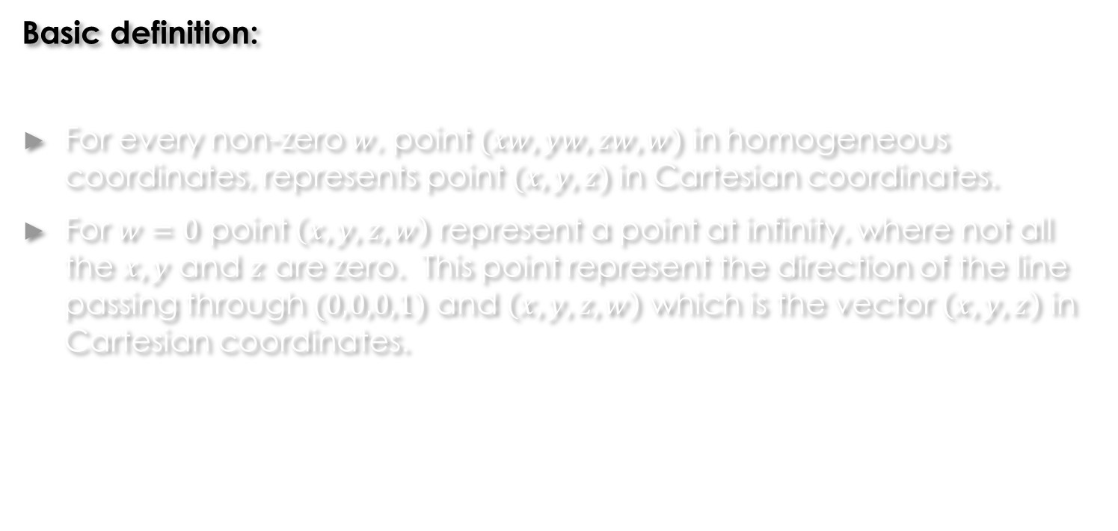
Homogeneous coordinates
Basic definition:
For every non-zero $w$, point $(xw, yw, zw, w)$ in homogeneous coordinates, represents point $(x, y, z)$in Cartesian coordinates.
For $w=0$ point $\left(x,y,z,w\right)$ represent a point at infinity, where not all the $x, y$ and $z$ are zero. This point represent the direction of the line passing through $(0,0,0,1)$ and $\left(x,y,z,w\right)$ which is the vector $\left(x,y,z\right)$ in Cartesian coordinates.
Notes:
The origin is $\left(0,0,0,1\right)$.
There is difference between points and vectors (directions).
$(0,0,0,0)$is omitted and does not represent any points; However, in CG this represents the $(0,0,0)$vector in Cartesian coordinates.
Multiplying a point by a non-zero number results in the same point.
Any two points where one can be obtained by multiplying the other by a non-zero number are the same.
As in the mathematical definition, $\left(x,y,z,0\right)$ and $(kx,ky.kz,0)$ are the same directions thus they are the same; However, in computer graphics these are two different vectors representing the same direction with different sizes.
Any $\left(x,y,z,w\right)$ where $x,y,z$ and $w$ are not all zeros represent a point in Cartesian coordinates.
Even though $w$ can be any non-zero, it’s common to normalize the vector by it’s $w$ components.
Using homogeneous coordinates allows linear transformations that are non-linear on Cartesian coordinates, such as projection.

Slide 5
Operations on vectors
We will discuss the following vector operation on homogeneous coordinates:
Length
Summation of two vectors
Summation of a vector and a point
Dot product of two vectors
Cross product of two vectors
Matrix multiplication
Notes:
As we discussed on the previous slide, $\left(x,y,z,0\right)$, where not all $x,y$ and $z$ are zero represents a vector and $\left(x,y,z,w\right)$ for a non-zero $w$ represents a point, so in homogeneous coordinates there is a difference between the points and vectors and the operations on them.
As you can see there is no summation of two points in the list above, that doesn’t mean that you can’t add two points together, of course you can, since each point is a 4D vector, it’s just it doesn’t mean a certain thing, and mostly isn’t done.

Slide 6
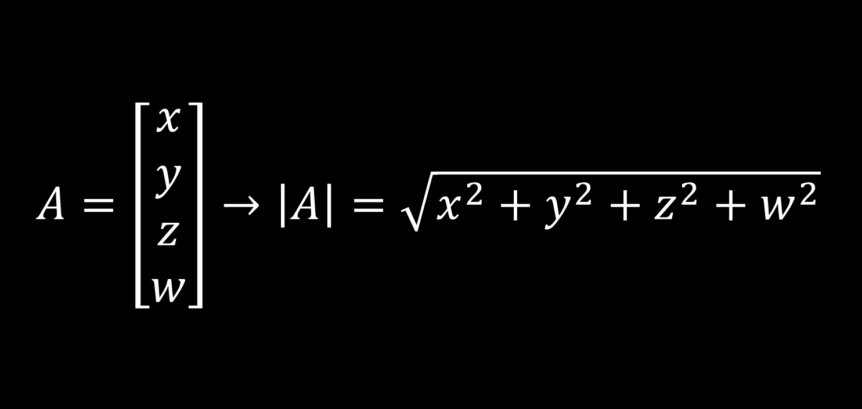
Summation of vector and vector
$$A=\left[\begin{aligned}x \\ y \\ z \\ w\end{aligned}\right]→\left|A\right|=\sqrt{x^{2}+y^{2}+z^{2}+w^{2}}$$
Notes:
Length of $A(x,y,z,w$) is represented by the notation $\left|A\right|$.
Any vector such that $\left|A\right|=1$ is a unit vector.

Slide 7
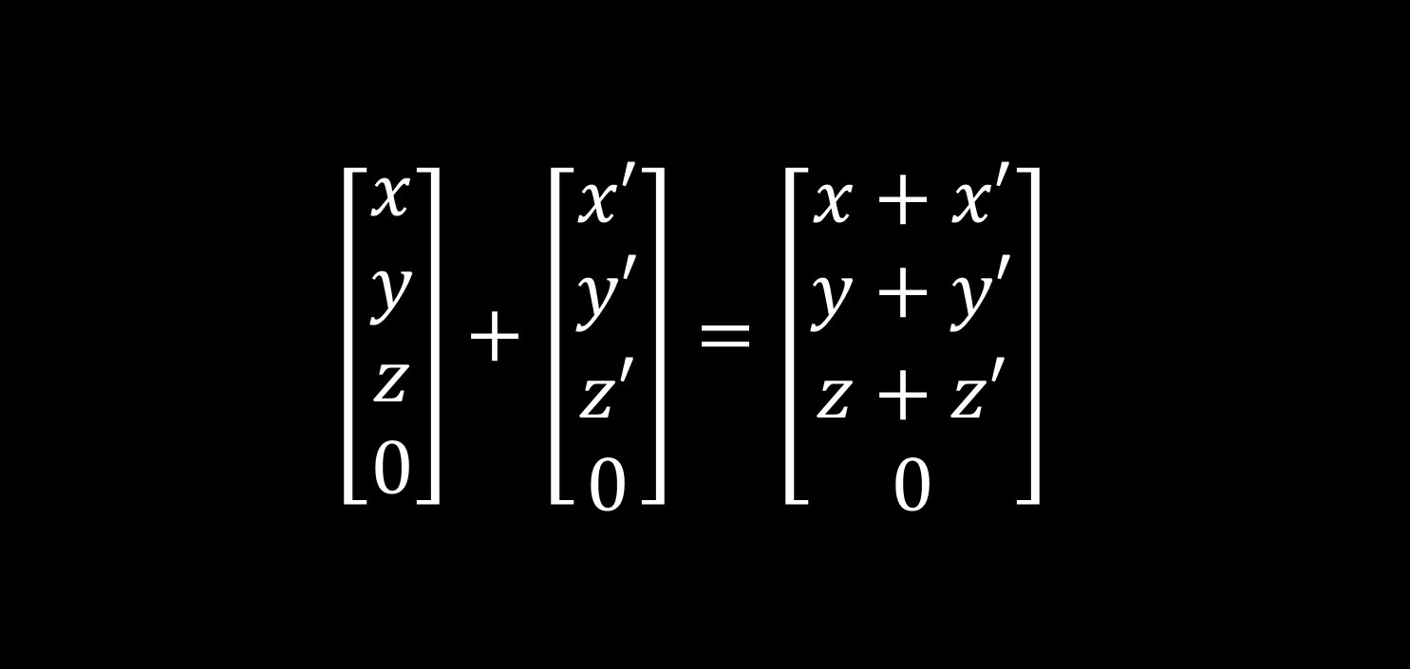
Summation of vector and vector
$$\left[\begin{aligned}x \\ y \\ z \\ 0\end{aligned}\right]+\left[\begin{aligned}x′ \\ y′ \\ z′ \\ 0\end{aligned}\right]=\left[\begin{aligned}x+x′ \\ y+y′ \\ z+z′ \\ 0\end{aligned}\right]$$
Notes:
The summation of two vectors results in a vector that represents the summation the Cartesian representation of operands.

Slide 8
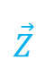
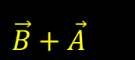
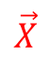



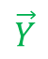
Summation of vector and vector
$$\vec{Z}$$
$$\vec{B}+\vec{A}$$
$$\vec{B}$$
$$\vec{A}$$
$$\vec{B}$$
$$\vec{X}$$
$$\vec{Y}$$
Notes:
The summation of two vectors results in a vector that represents the summation the Cartesian representation of operands.

Slide 9
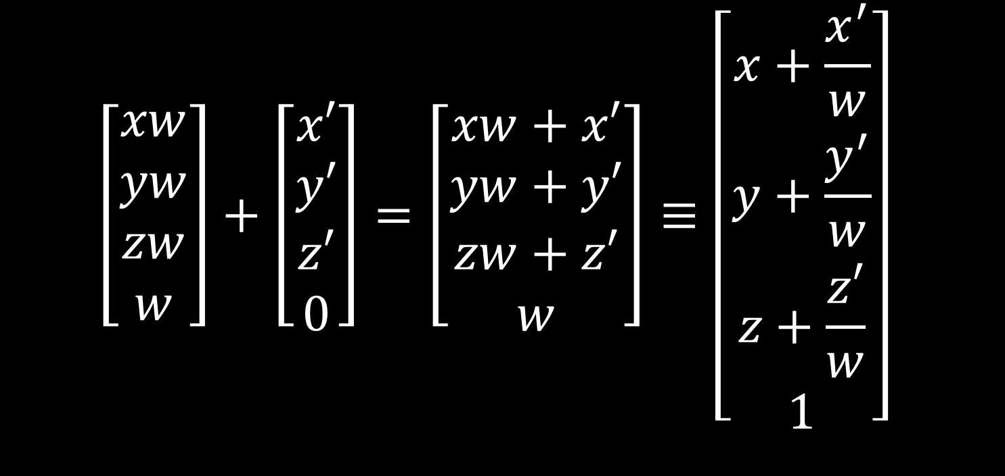
Summation of a vector and a point
$$\left[\begin{aligned}xw \\ yw \\ zw \\ w\end{aligned}\right]+\left[\begin{aligned}x′ \\ y′ \\ z′ \\ 0\end{aligned}\right]=\left[\begin{aligned}xw+x′ \\ yw+y′ \\ zw+z′ \\ w\end{aligned}\right]≡\left[\begin{aligned}x+\frac{x^{′}}{w} \\ y+\frac{y^{′}}{w} \\ z+\frac{z′}{w} \\ 1\end{aligned}\right]$$
Notes:
Summation of a vector and a point results in a point that represents the translation of the point by the vector.

Slide 10
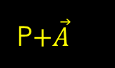


Summation of a vector and a point
$$\vec{Z}$$
P$+\vec{A}$
$$\vec{A}$$
$$P$$
$$\vec{X}$$
$$\vec{Y}$$
Notes:
Summation of a vector and a point results in a point that represents the translation of the point by the vector.

Slide 11
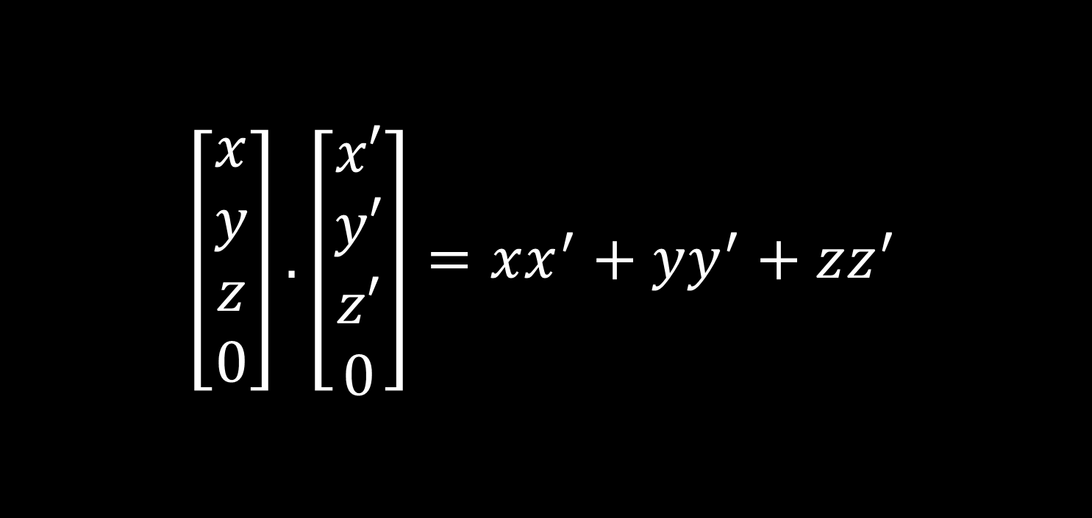
Dot product
$$\left[\begin{aligned}x \\ y \\ z \\ 0\end{aligned}\right].\left[\begin{aligned}x′ \\ y′ \\ z′ \\ 0\end{aligned}\right]=xx^{′}+yy^{′}+zz^{′}$$
Notes:
Dot product of two vectors is the same as the dot product of their Cartesian representations, which for given vectors $A(x,y,z,0)$and $B\left(x^{′},y^{′},z^{′},0\right)$ we have: $A.B=\left|A\right|\left|B\right|\cos{θ}$ where $θ$ is the angle between two vectors.

Slide 12
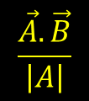

Dot product
$$\vec{Z}$$
$$\vec{B}$$
$$\vec{A}$$
$$\frac{\vec{A}.\vec{B}}{\left|A\right|}$$
$$\vec{X}$$
$$\vec{Y}$$
Notes:
Dot product of two vectors is the same as the dot product of their Cartesian representations, which for given vectors $A(x,y,z,0)$and $B\left(x^{′},y^{′},z^{′},0\right)$ we have: $A.B=\left|A\right|\left|B\right|\cos{θ}$ where $θ$ is the angle between two vectors.

Slide 13
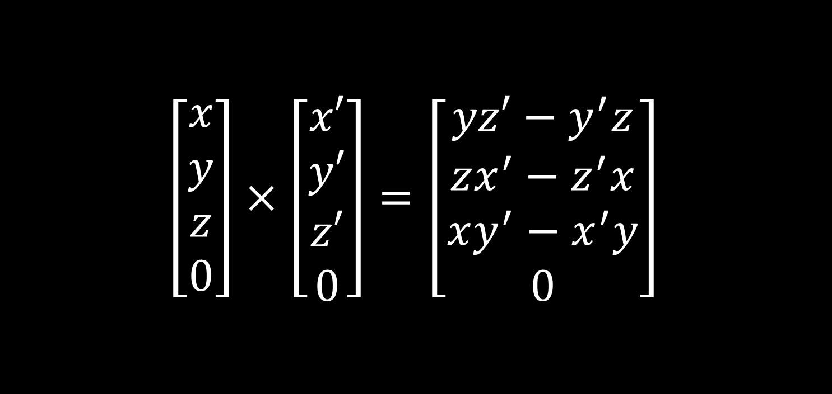
Cross product of two vectors
$$\left[\begin{aligned}x \\ y \\ z \\ 0\end{aligned}\right]×\left[\begin{aligned}x′ \\ y′ \\ z′ \\ 0\end{aligned}\right]=\left[\begin{aligned}yz′−y^{′}z \\ zx^{′}−z^{′}x \\ xy^{′}−x^{′}y \\ 0\end{aligned}\right]$$
Notes:
The dot product of two vectors is a vector representing the Cartesian vector that is perpendicular to the Cartesian representation of the vectors. I could not find any mathematical reference on this one, though this is the definition we’re going to use.

Slide 14
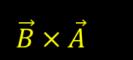

Cross product of two vectors
$$\vec{Z}$$
$$\vec{B}×\vec{A}$$
$$\vec{B}$$
$$\vec{A}$$
$$\vec{X}$$
$$\vec{Y}$$
Notes:
The dot product of two vectors is a vector representing the Cartesian vector that is perpendicular to the Cartesian representation of the vectors. I could not find any mathematical reference on this one, though this is the definition we’re going to use.

Slide 15
Matrix multiplication
Matrix multiplications allows linear transformation in homogenous space, which isn’t necessarily linear in Cartesian space.
These transformations are:
Scaling
Translation
Rotation
Rotation about arbitrary axis
Change of basis
Projection
Notes:
As you know projection is a not linear transformation in Cartesian space, though it is linear in homogenous space.

Slide 16
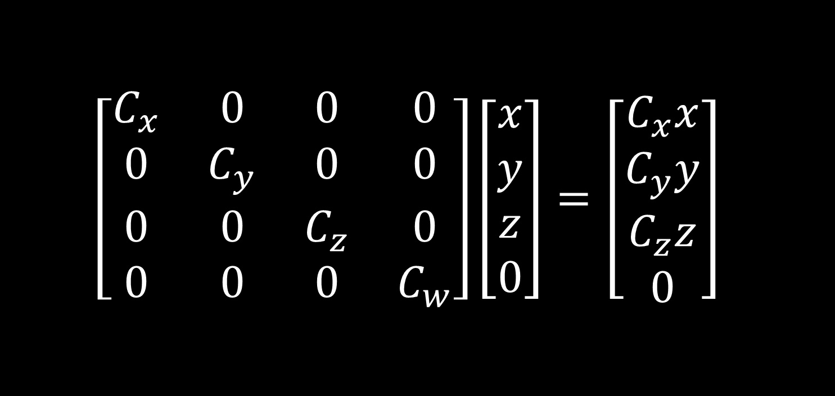
Scaling
$$\left[\begin{matrix}C_{x} & 0 & 0 & 0 \\ 0 & C_{y} & 0 & 0 \\ 0 & 0 & C_{z} & 0 \\ 0 & 0 & 0 & C_{w}\end{matrix}\right]\left[\begin{matrix}x \\ y \\ z \\ 0\end{matrix}\right]=\left[\begin{matrix}C_{x}x \\ C_{y}y \\ C_{z}z \\ 0\end{matrix}\right]$$
Notes:
The diagonal matrix notation is $diag\left(C_{x},C_{y},C_{z},C_{w}\right)$ (commonly known as non-uniform scalar matrix).
If $C_{x}=C_{y}=C_{z}=C_{w}$then the diagonal matrix is called scalar matrix.
Scaling a point with a scalar matrix results in the same point.
Scaling a vector with scalar matrix results in a vector with same direction and scaled length.
Scaling a vector with a diagonal matrix results in a vector with different direction and possibly size.

Slide 17
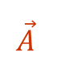
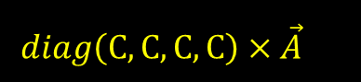
Scaling
$$\vec{Z}$$
$$diag\left(C,C,C,C\right)×\vec{A}$$
$$\vec{A}$$
$$\vec{X}$$
$$\vec{Y}$$
Notes:
The diagonal matrix notation is $diag\left(C_{x},C_{y},C_{z},C_{w}\right)$ (commonly known as non-uniform scalar matrix).
If $C_{x}=C_{y}=C_{z}=C_{w}$then the diagonal matrix is called scalar matrix.
Scaling a point with a scalar matrix results in the same point.
Scaling a vector with scalar matrix results in a vector with same direction and scaled length.
Scaling a vector with a diagonal matrix results in a vector with different direction and possibly size.

Slide 18
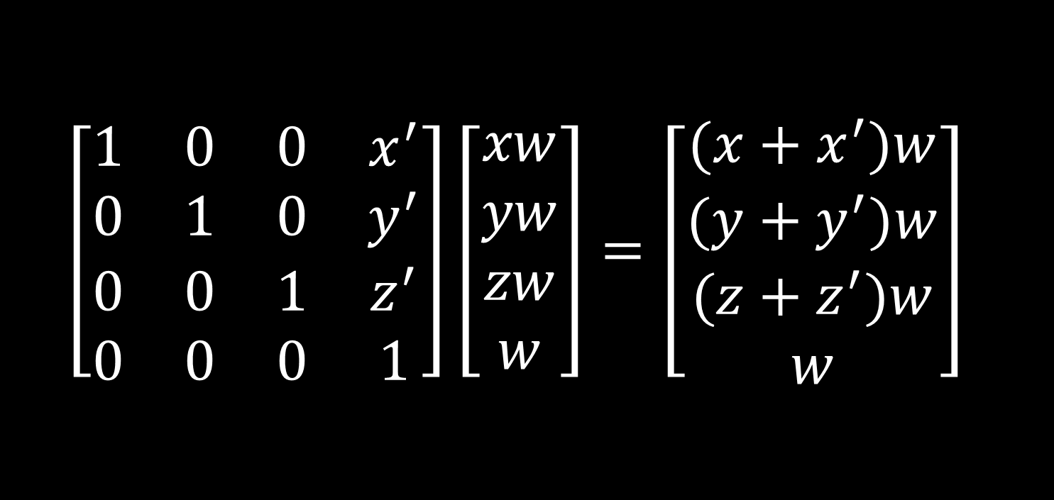
Translation
$$\left[\begin{matrix}1 & 0 & 0 & x^{′} \\ 0 & 1 & 0 & y^{′} \\ 0 & 0 & 1 & z^{′} \\ 0 & 0 & 0 & 1\end{matrix}\right]\left[\begin{matrix}xw \\ yw \\ zw \\ w\end{matrix}\right]=\left[\begin{matrix}(x+x^{′})w \\ (y+y^{′})w \\ (z+z^{′})w \\ w\end{matrix}\right]$$
Notes:
The translation matrix $T_{\vec{V}}$ translates points by $\vec{V}\left(x^{′}, {y^{′},z}^{′},0\right)$ and has no effects on vectors.

Slide 19
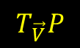

Translation
$$\vec{Z}$$
$$T_{\vec{V}}P$$
$$\vec{V}$$
$$P$$
$$\vec{X}$$
$$\vec{Y}$$
Notes:
The translation matrix $T_{\vec{V}}$ translates points by $\vec{V}\left(x^{′}, {y^{′},z}^{′},0\right)$ and has no effects on vectors.

Slide 20
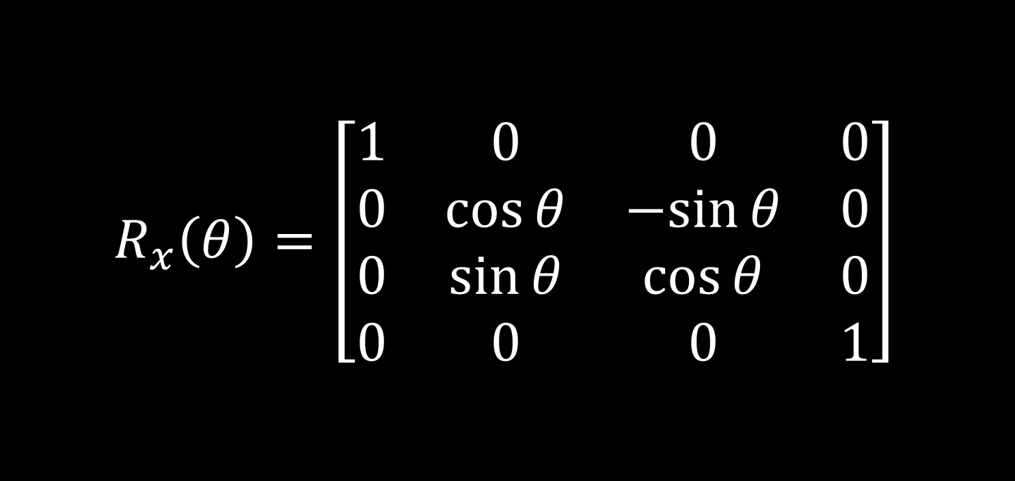

Rotation about $X$ axis
$$R_{x}\left(θ\right)=\left[\begin{matrix}1 & 0 & 0 & 0 \\ 0 & \cos{θ} & −sin{θ} & 0 \\ 0 & \sin{θ} & \cos{θ} & 0 \\ 0 & 0 & 0 & 1\end{matrix}\right]$$
Notes:
Rotation matrices rotate both points and vectors.

Slide 21
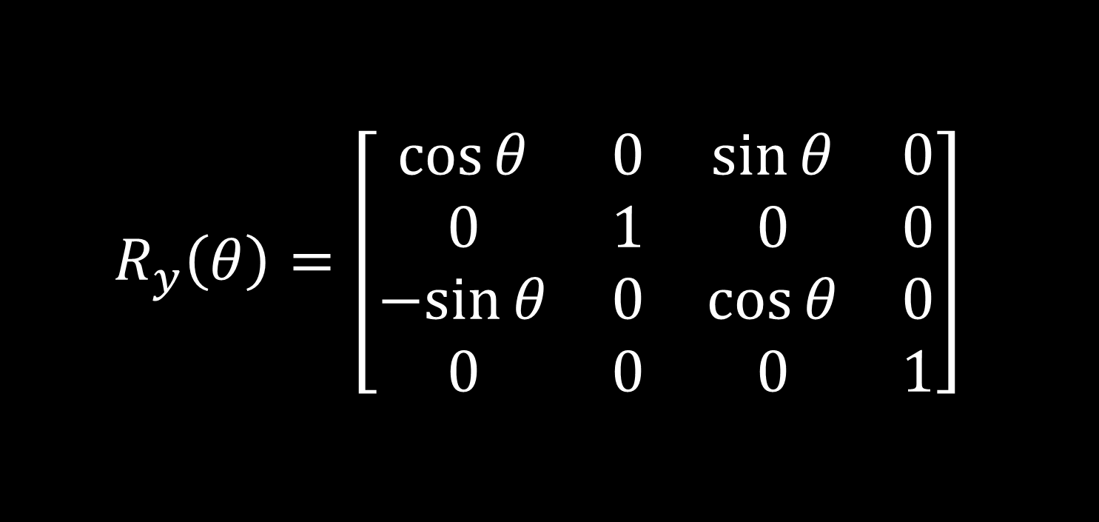

Rotation about $Y$ axis
$$R_{y}\left(θ\right)=\left[\begin{matrix}\cos{θ} & 0 & \sin{θ} & 0 \\ 0 & 1 & 0 & 0 \\ −sin{θ} & 0 & \cos{θ} & 0 \\ 0 & 0 & 0 & 1\end{matrix}\right]$$

Slide 22
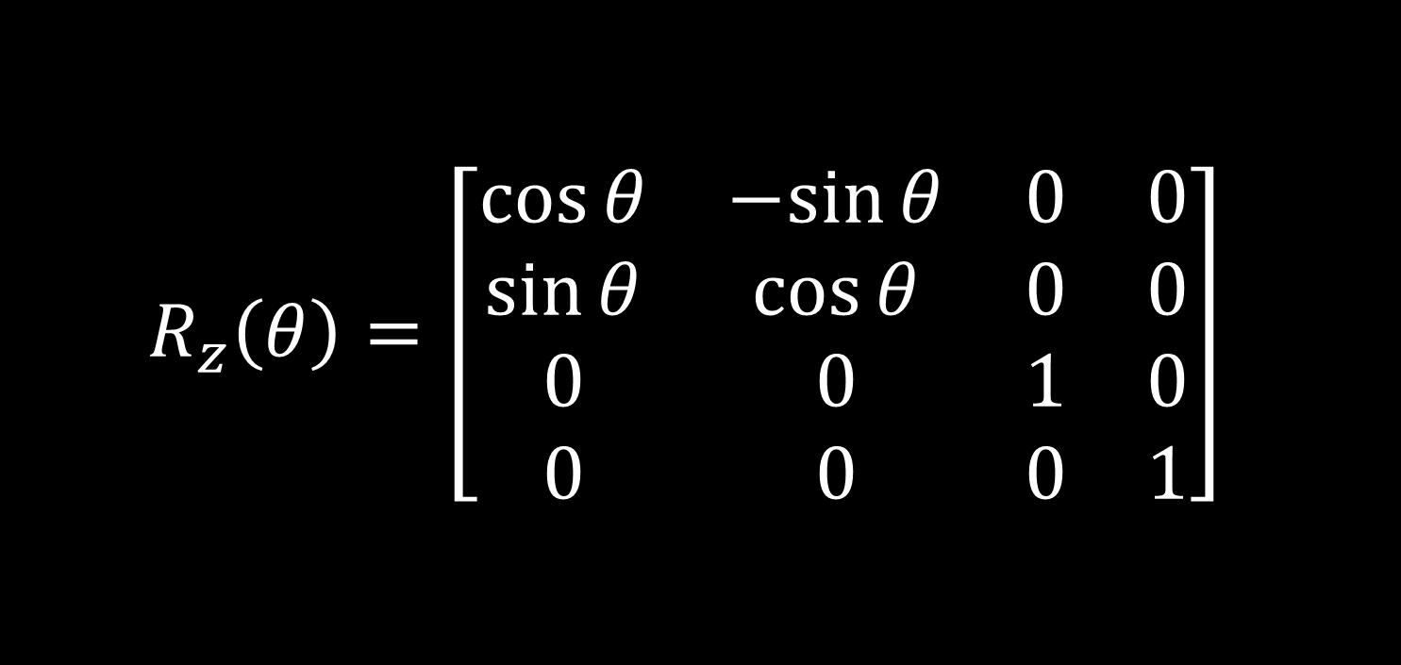

Rotation about $Z$ axis
$$R_{z}\left(θ\right)=\left[\begin{matrix}\cos{θ} & −sin{θ} & 0 & 0 \\ \sin{θ} & \cos{θ} & 0 & 0 \\ 0 & 0 & 1 & 0 \\ 0 & 0 & 0 & 1\end{matrix}\right]$$

Slide 23
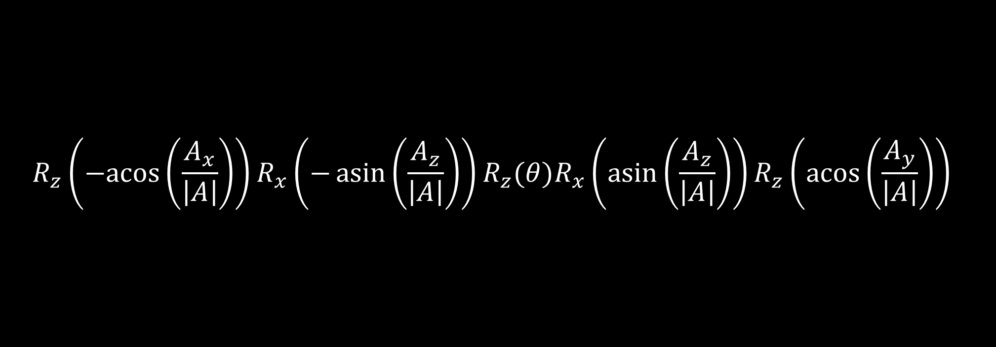
Rotation about arbitrary axis
$$R_{z}\left(−acos\left(\frac{A_{x}}{\left|A\right|}\right)\right)R_{x}\left(−\operatorname{asin}\left(\frac{A_{z}}{\left|A\right|}\right)\right)R_{z}(θ)R_{x}\left(\operatorname{asin}\left(\frac{A_{z}}{\left|A\right|}\right)\right)R_{z}\left(\operatorname{acos}\left(\frac{A_{y}}{\left|A\right|}\right)\right)$$
Notes:
Given a unit vector $A(A_{x},A_{y},A_{z})$ as axis, the rotation matrix about this vector is calculated as above.
The first two rotations from right rotate the vector such that $A$ sits on $Z$ axis then the middle rotation rotates the point or vector about $Z$ axis which is $A$ and then undoes the first two rotations, causing the point or vector to rotate about $A$.

Slide 24
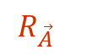
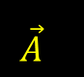
Rotation about arbitrary axis
$$\vec{Z}$$
$$\vec{A}$$
$$R_{\vec{A}}$$
$$\vec{X}$$
$$\vec{Y}$$
Notes:
Given a unit vector $A(A_{x},A_{y},A_{z})$ as axis, the rotation matrix about this vector is calculated as above.
The first two rotations from right rotate the vector such that $A$ sits on $Z$ axis then the middle rotation rotates the point or vector about $Z$ axis which is $A$ and then undoes the first two rotations, causing the point or vector to rotate about $A$.

Slide 25
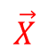
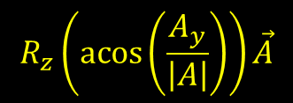
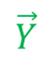
Rotation about arbitrary axis
$$\vec{Z}$$
$$R_{z}\left(\operatorname{acos}\left(\frac{A_{y}}{\left|A\right|}\right)\right)\vec{A}$$
$$\vec{Y}$$
$$\vec{X}$$
Notes:
Given a unit vector $A(A_{x},A_{y},A_{z})$ as axis, the rotation matrix about this vector is calculated as above.
The first two rotations from right rotate the vector such that $A$ sits on $Z$ axis then the middle rotation rotates the point or vector about $Z$ axis which is $A$ and then undoes the first two rotations, causing the point or vector to rotate about $A$.

Slide 26
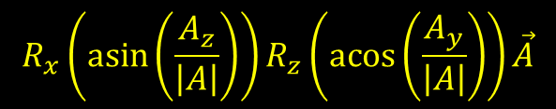
Rotation about arbitrary axis
$$\vec{Z}$$
$$R_{x}\left(\operatorname{asin}\left(\frac{A_{z}}{\left|A\right|}\right)\right)R_{z}\left(\operatorname{acos}\left(\frac{A_{y}}{\left|A\right|}\right)\right)\vec{A}$$
$$\vec{X}$$
$$\vec{Y}$$
Notes:
Given a unit vector $A(A_{x},A_{y},A_{z})$ as axis, the rotation matrix about this vector is calculated as above.
The first two rotations from right rotate the vector such that $A$ sits on $Z$ axis then the middle rotation rotates the point or vector about $Z$ axis which is $A$ and then undoes the first two rotations, causing the point or vector to rotate about $A$.

Slide 27
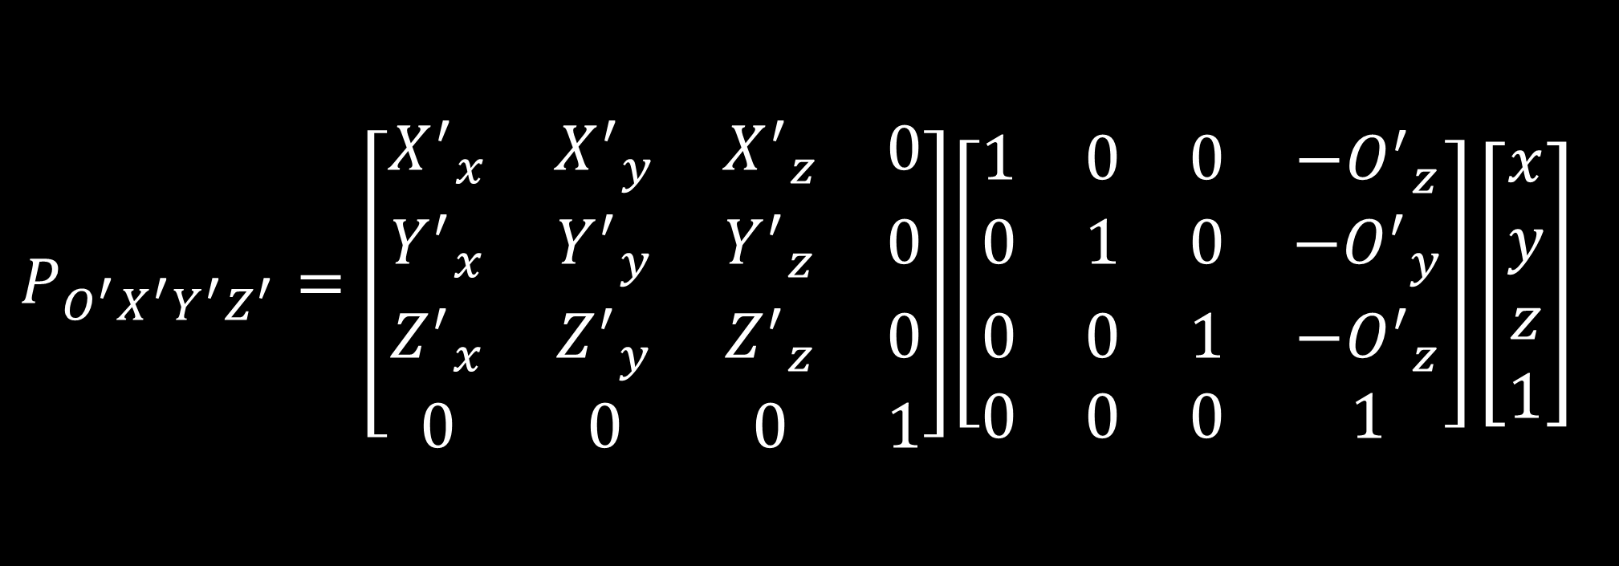
Change of basis
$$P_{O^{′}X^{′}Y^{′}Z^{′}}=\left[\begin{matrix}{X^{′}}_{x} & {X^{′}}_{y} & {X^{′}}_{z} & 0 \\ {Y^{′}}_{x} & {Y^{′}}_{y} & {Y^{′}}_{z} & 0 \\ {Z^{′}}_{x} & {Z^{′}}_{y} & {Z^{′}}_{z} & 0 \\ 0 & 0 & 0 & 1\end{matrix}\right]\left[\begin{matrix}1 & 0 & 0 & −{O^{′}}_{z} \\ 0 & 1 & 0 & {−O^{′}}_{y} \\ 0 & 0 & 1 & {−O^{′}}_{z} \\ 0 & 0 & 0 & 1\end{matrix}\right]\left[\begin{matrix}x \\ y \\ z \\ 1\end{matrix}\right]$$
Notes:
Given three arbitrary unit vectors $X^{′}\left({X^{′}}_{x},{X^{′}}_{y},{X^{′}}_{z},0\right)$, $Y^{′}\left({Y^{′}}_{x},{Y^{′}}_{y},{Y^{′}}_{z},0\right)$ and $Z^{′}\left({Z^{′}}_{x},{Z^{′}}_{y},{Z^{′}}_{z},0\right)$ as new axes and a point $O^{′}\left({O^{′}}_{x},{O^{′}}_{y},{O^{′}}_{z},1\right)$ as origin. The coordinate in new basis can be acquired from formula.
What the formula does, is to translate the given point according to the new origin and then it rotates the point to fit the new axes.

Slide 28

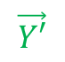

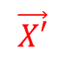
Change of basis
$$\vec{Z}$$
$$\vec{Z′}$$
$$\vec{X′}$$
O$′$
$$\vec{X}$$
$$\vec{Y}$$
$$\vec{Y′}$$
Notes:
Given three arbitrary unit vectors $X^{′}\left({X^{′}}_{x},{X^{′}}_{y},{X^{′}}_{z},0\right)$, $Y^{′}\left({Y^{′}}_{x},{Y^{′}}_{y},{Y^{′}}_{z},0\right)$ and $Z^{′}\left({Z^{′}}_{x},{Z^{′}}_{y},{Z^{′}}_{z},0\right)$ as new axes and a point $O^{′}\left({O^{′}}_{x},{O^{′}}_{y},{O^{′}}_{z},1\right)$ as origin. The coordinate in new basis can be acquired from formula.
What the formula does, is to translate the given point according to the new origin and then it rotates the point to fit the new axes.

Slide 29
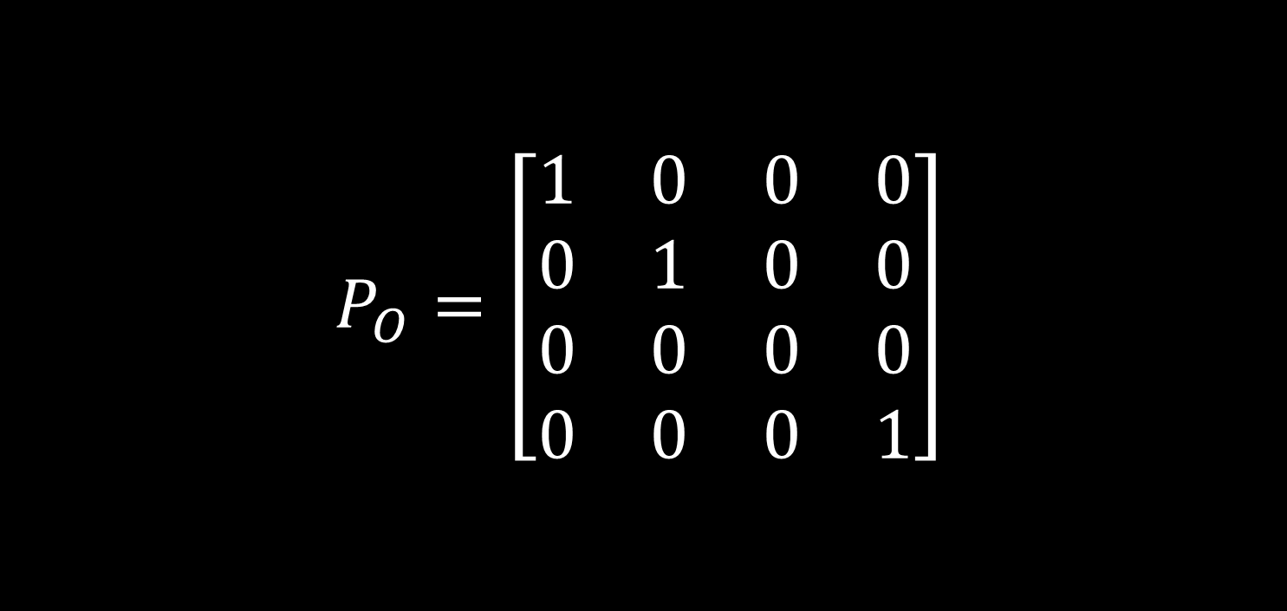
Orthogonal Projection
$$P_{O}=\left[\begin{matrix}1 & 0 & 0 & 0 \\ 0 & 1 & 0 & 0 \\ 0 & 0 & 0 & 0 \\ 0 & 0 & 0 & 1\end{matrix}\right]$$
Notes:
This matrix projects given point orthogonally onto the $xy$ plain. To change the projection plain you can translate and rotates the point before projection such that the arbitrary plain sits on the $xy$ plain and undo the translations and rotations after the projection.

Slide 30
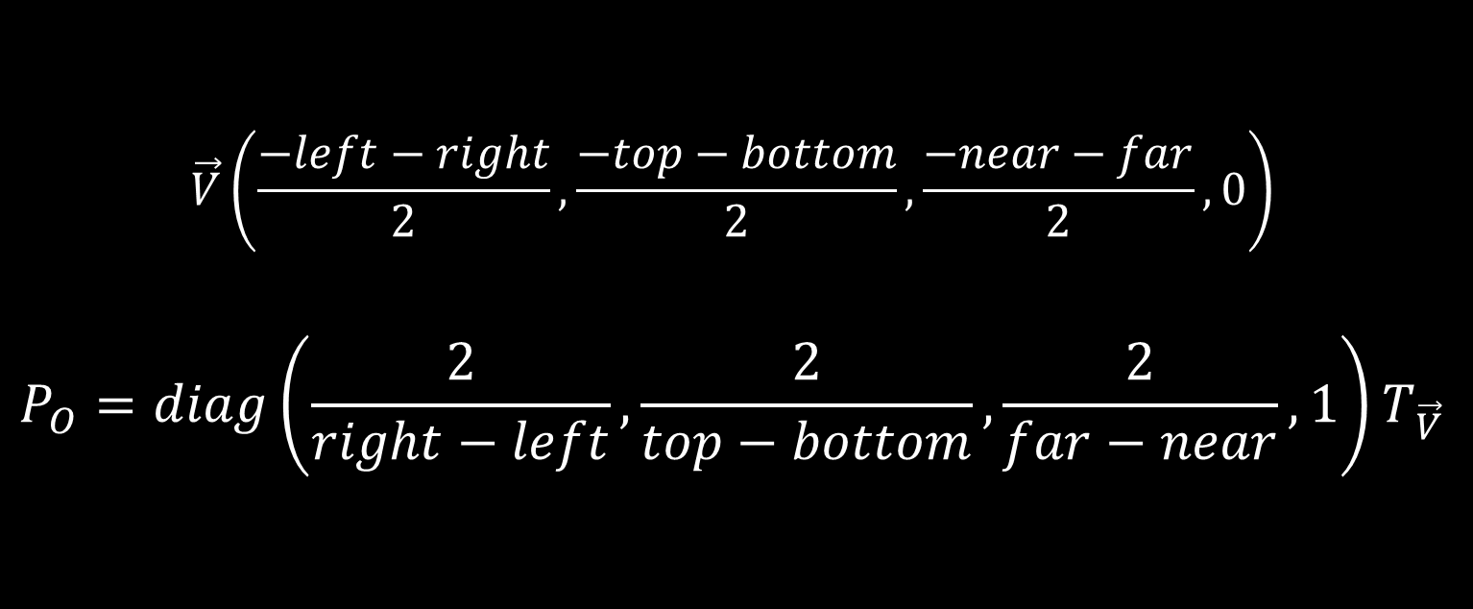
Orthogonal Projection Onto a Box
$$\vec{V}\left(\frac{−left−right}{2},\frac{−top−bottom}{2},\frac{−near−far}{2},0\right)$$
$$P_{O}=diag\left(\frac{2}{right−left},\frac{2}{top−bottom},\frac{2}{far−near},1\right)T_{\vec{V}}$$
Notes:
This is the matrix that is most commonly used in computer graphics to project a point orthogonally onto a box.
To do so the coordinates inside the box are normalized and values $x,y,z<−1 or x,y,z>1$ are considered out of the box (this is actually a projection of box onto a box). The coordinates in this space is called NDC (short for normalized device coordinates).
A projection is defined by a rectangle (start $x,y$ and end $x,y$ (left, right, top, bottom)) and the $z_{0}$ (near) value of it’s surface.
It’s common to clip the end of the box by normalizing the $z$ component inside the box as well.
The clipping $z$ is called far value.
This matrix does all the above.

Slide 31
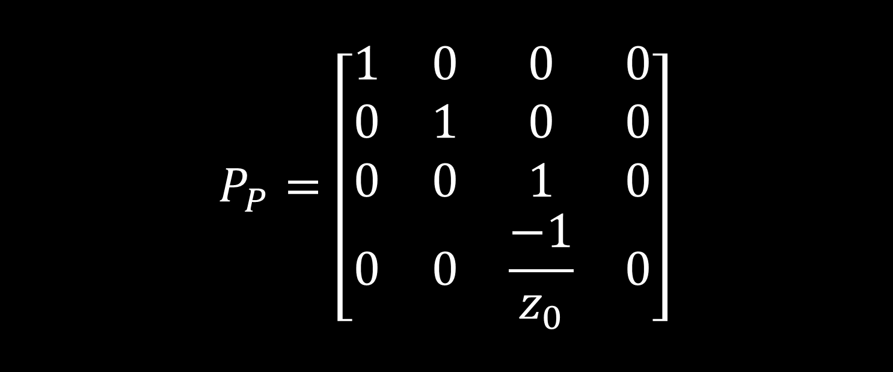
Perspective Projection
$$P_{P}=\left[\begin{matrix}1 & 0 & 0 & 0 \\ 0 & 1 & 0 & 0 \\ 0 & 0 & 1 & 0 \\ 0 & 0 & \frac{−1}{z_{0}} & 0\end{matrix}\right]$$
Notes:
This matrix projects a point that is normalized by it’s $w$ component onto the $z=z_{0}$ plain using the point $P(0,0,0)$. To change projection plain and point, you can translate and rotate the arbitrary projection plain and point to sit on the $xy$ plain and point $P$.

Slide 32
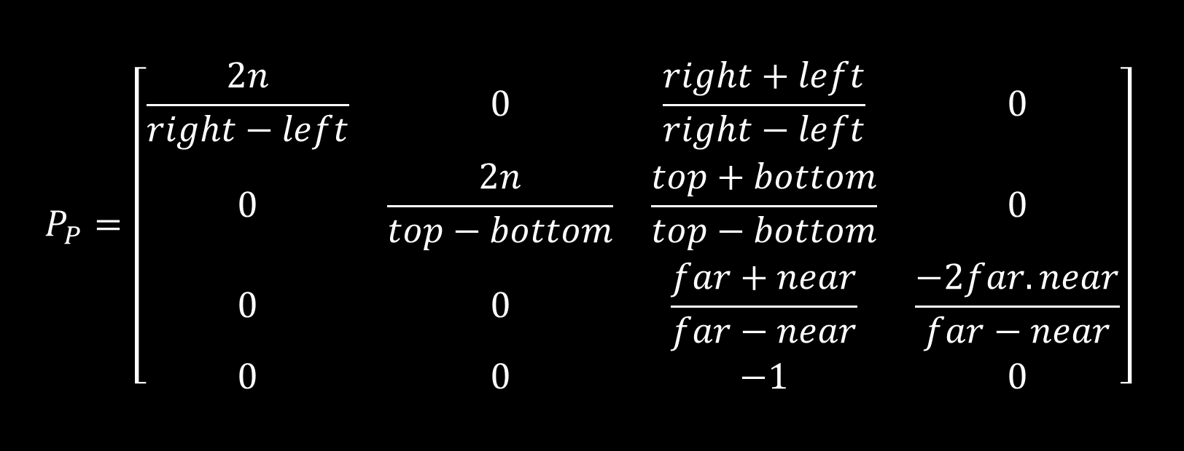
Perspective Projection
$$P_{P}=\left[\begin{matrix}\frac{2n}{right−left} & 0 & \frac{right+left}{right−left} & 0 \\ 0 & \frac{2n}{top−bottom} & \frac{top+bottom}{top−bottom} & 0 \\ 0 & 0 & \frac{far+near}{far−near} & \frac{−2far.near}{far−near} \\ 0 & 0 & −1 & 0\end{matrix}\right]$$
Notes:
This is matrix commonly used for projection in 3D renderers.
This matrix projects a frustum onto a cube.
The frustum is of the pyramid that is defined by point $\left(0,0,0,1\right)$ and the rectangle defined by $top,left$ and $bottom,right$.
There is a little difference between this matrix and the one that is used in 3D renderers, the one used in 3D renderers has the negation on the element $\left(3,3\right)$.
This matrix projects the point on to the $xy$ plain and then gives it a non-linear $z$ value to the point calculated by the $z$ value of the point projecting a frustum on to a box.
The division parts of this matrix are scaling the point’s components such that they sit in the range $\left(−1,1\right)$.
The third column translates the frustum such that the center of the matrix sits on the origin.
The element $\left(4,3\right)$ causes the result’s $w$ value to become the point’s $z$ causing a perspective projection, and a none linear transform in the Cartesian space.

Slide 33
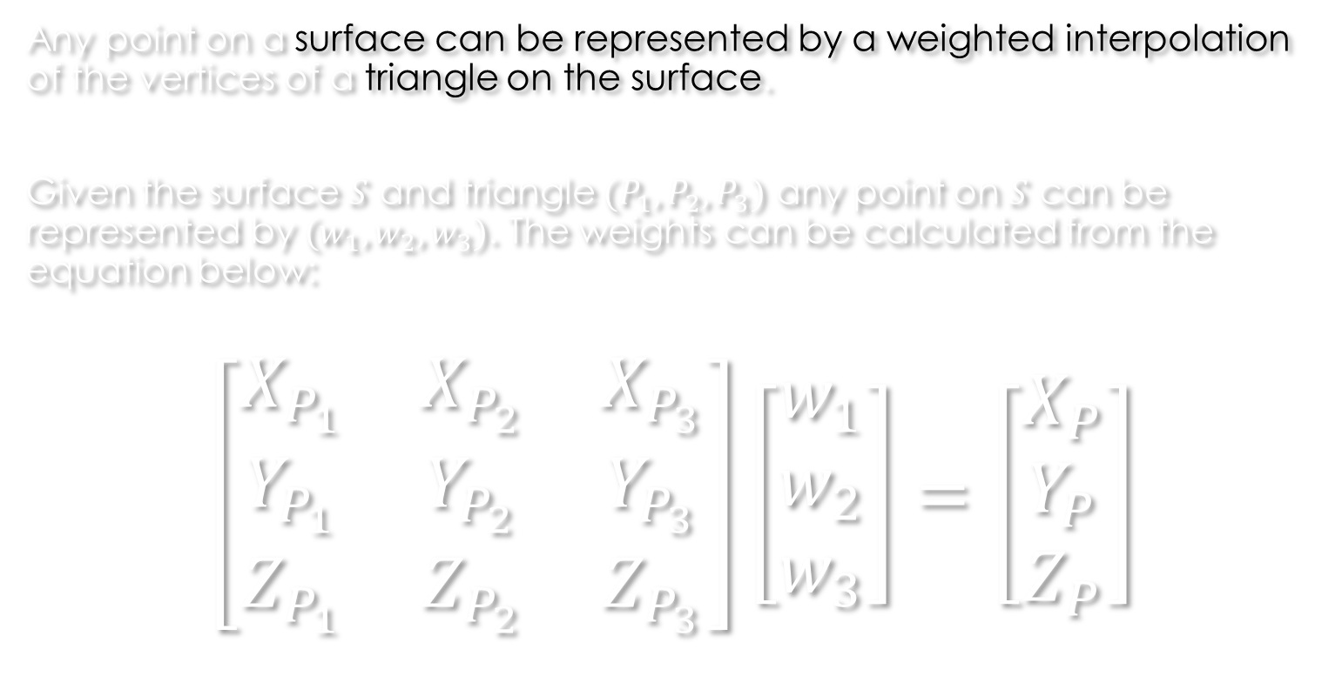
Barycentric coordinates
Any point on a surface can be represented by a weighted interpolation of the vertices of a triangle on the surface.
Given the surface $S$ and triangle $(P_{1},P_{2},P_{3})$ any point on $S$ can be represented by $(w_{1},w_{2},w_{3})$. The weights can be calculated from the equation below:
$$\left[\begin{matrix}X_{P_{1}} & X_{P_{2}} & X_{P_{3}} \\ Y_{P_{1}} & Y_{P_{2}} & Y_{P_{3}} \\ Z_{P_{1}} & Z_{P_{2}} & Z_{P_{3}}\end{matrix}\right]\left[\begin{matrix}w_{1} \\ w_{2} \\ w_{3}\end{matrix}\right]=\left[\begin{matrix}X_{P} \\ Y_{P} \\ Z_{P}\end{matrix}\right]$$
Notes:
This equation comes from the definition:
$$P=w_{1}P_{1}+w_{2}P_{2}+w_{3}P_{3}$$
$\left(w_{1},w_{2},w_{3}\right)$ is called the barycentric coordinates of the point.
The equation above is guaranteed to have a single answer for every points on $S$ given that $\left(P_{1},P_{2},P_{3}\right)$ is a triangle.

Slide 34
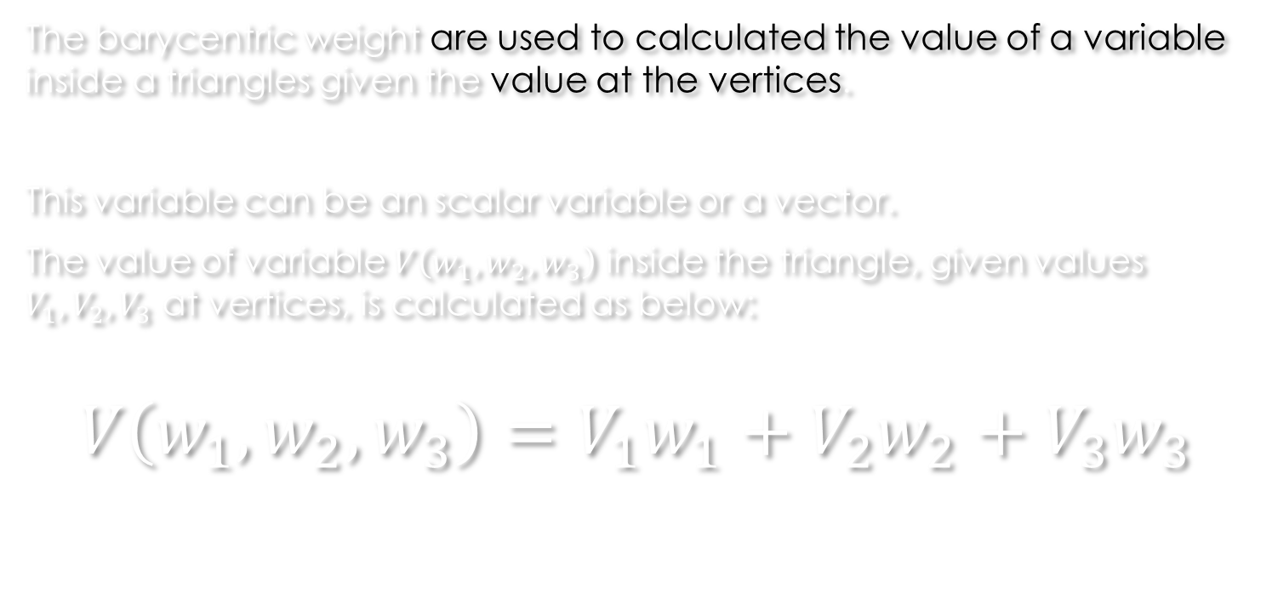
Barycentric interpolation
The barycentric weight are used to calculated the value of a variable inside a triangles given the value at the vertices.
This variable can be an scalar variable or a vector.
The value of variable $V\left(w_{1},w_{2},w_{3}\right)$ inside the triangle, given values $V_{1},V_{2},V_{3}$ at vertices, is calculated as below:
$$V\left(w_{1},w_{2},w_{3}\right)=V_{1}w_{1}+V_{2}w_{2}+V_{3}w_{3}$$
Notes:
Inside the triangle, $w_{1}+w_{2}+w_{3}=1$ is guaranteed. This means that $V\left(w_{1},w_{2},w_{3}\right)$ is a weighted average of the values at vertices.

Slide 35
Your questions

Slide 36
Helpful links
http://www.songho.ca/opengl/gl_projectionmatrix.html (projection reference)
http://mathworld.wolfram.com/BarycentricCoordinates.html (barycentric coordinates)
Notes:
http://www.songho.ca/opengl/gl_projectionmatrix.html (projection reference)
http://mathworld.wolfram.com/BarycentricCoordinates.html (barycentric coordinates)

